Slide 1

Power
The idea of power incorporates both the concepts of work and time.
Power is work done per unit time.
Average power, P is the average rate at which work W is done, and it is obtained by dividing W by the time t required to perform the work:
Power is a scalar. Unit of power: watt = W = J/s (SI unit) or ft.lb/s
Horsepower (hp) is another larger unit for power.
1hp = 550 ft.lb/s or 1hp = 745.7 W

Slide 2
Estimating the cost of Electricity
34. A large household air conditioner may consume 15.0 kW of power. What is the cost of operating this air conditioner 3.00 h per day for 30.0 d if the cost of electricity is $0.110 per kW ⋅ h ?

Slide 3
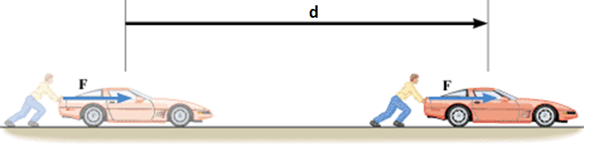
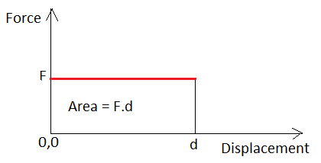
Force versus Distance Graph
Work = Area under the Force versus Displacement graph

Slide 4
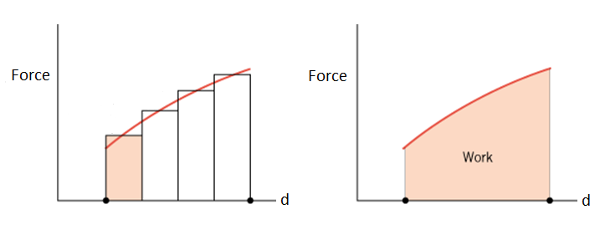
Work Done by a Variable Force
The work done by a variable force in moving an object is equal to the area under the graph of Force versus displacement.

Slide 5

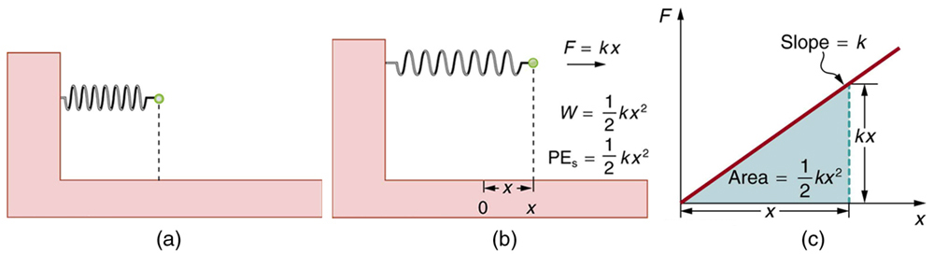
Hooke’s law and
Elastic Potential Energy

Slide 6
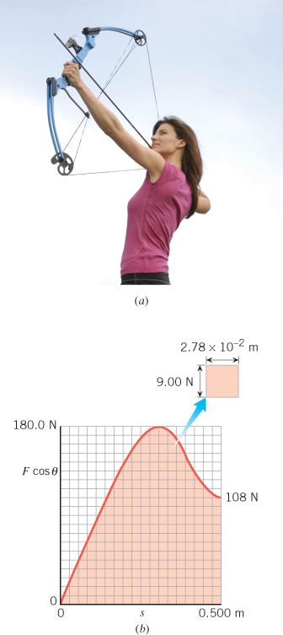
Work and the Compound Bow
Find the work that the archer must do in drawing back the string of the compound bow in the Figure from 0 to 0.500 m.

